Slide 1

Australia and New Zealand PowerShell User Group September 2018
 https://ANZPSUG.github.io
 https://twitter.com/ANZPSUG
 https://www.meetup.com/ANZ-PowerShell-UserGroup

Slide 2



ANZPSUG Co-Organisers
Adam Murray (AUS) @muzzar78 |  | Charbel Aghnatios (AUS) @Charbs_Security |  | Josh King (NZ) @WindosNZ

Slide 3
October ANZPSUG Meeting
Monday 8th October
Online (Skype for Business)
8 PM here in NZ
Daniel Silva presenting: “Power Your Raspberry Shell on It’s Core. Raspberry Pi + PowerShell Core”

Slide 4
Tonight’s Agenda
6 PM – Meeting start, casual chat, wait for people to arrive
6:05 PM – Welcome & meeting intro
6:10 PM – PowerShell Scheduled Jobs and Toast Notifications!
6:50 PM-ish – Book Giveaway

Slide 5
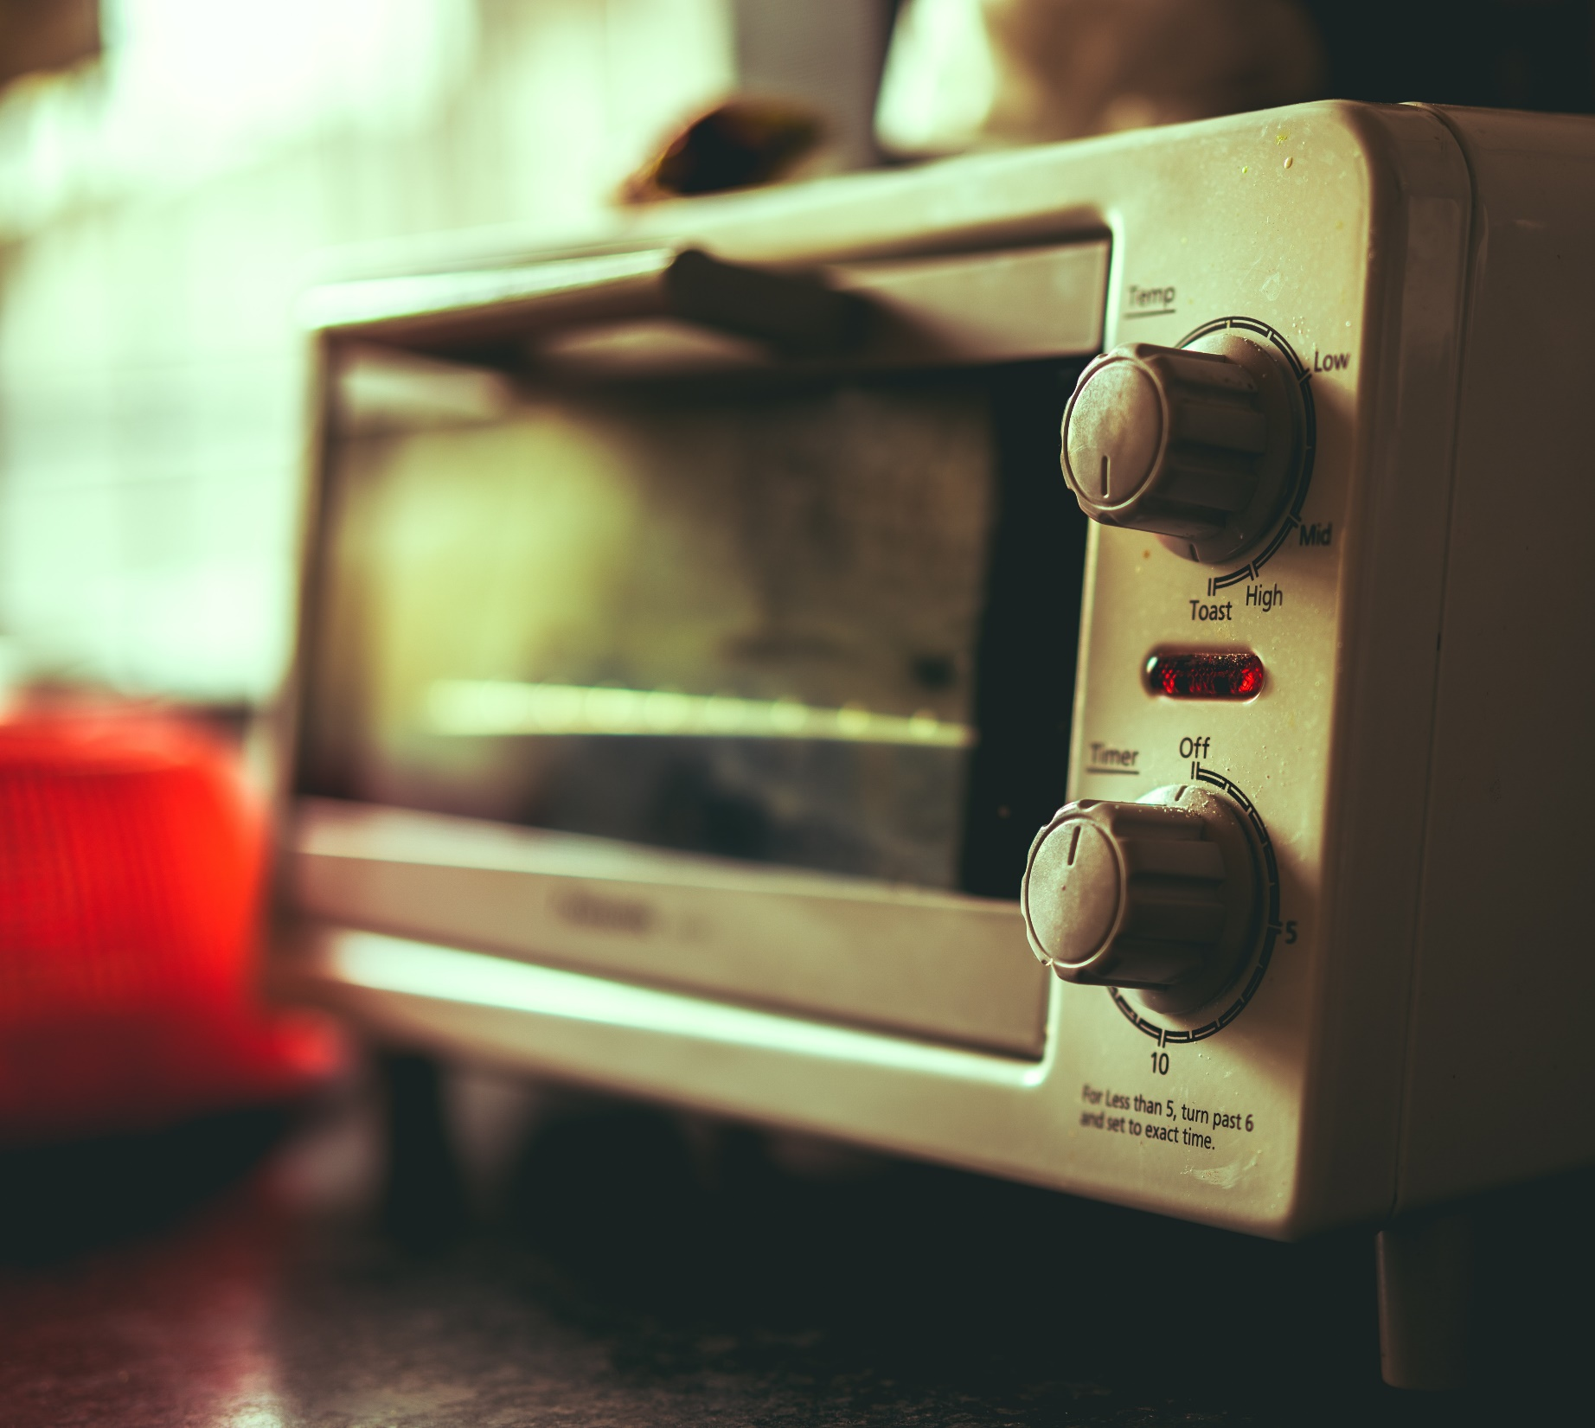
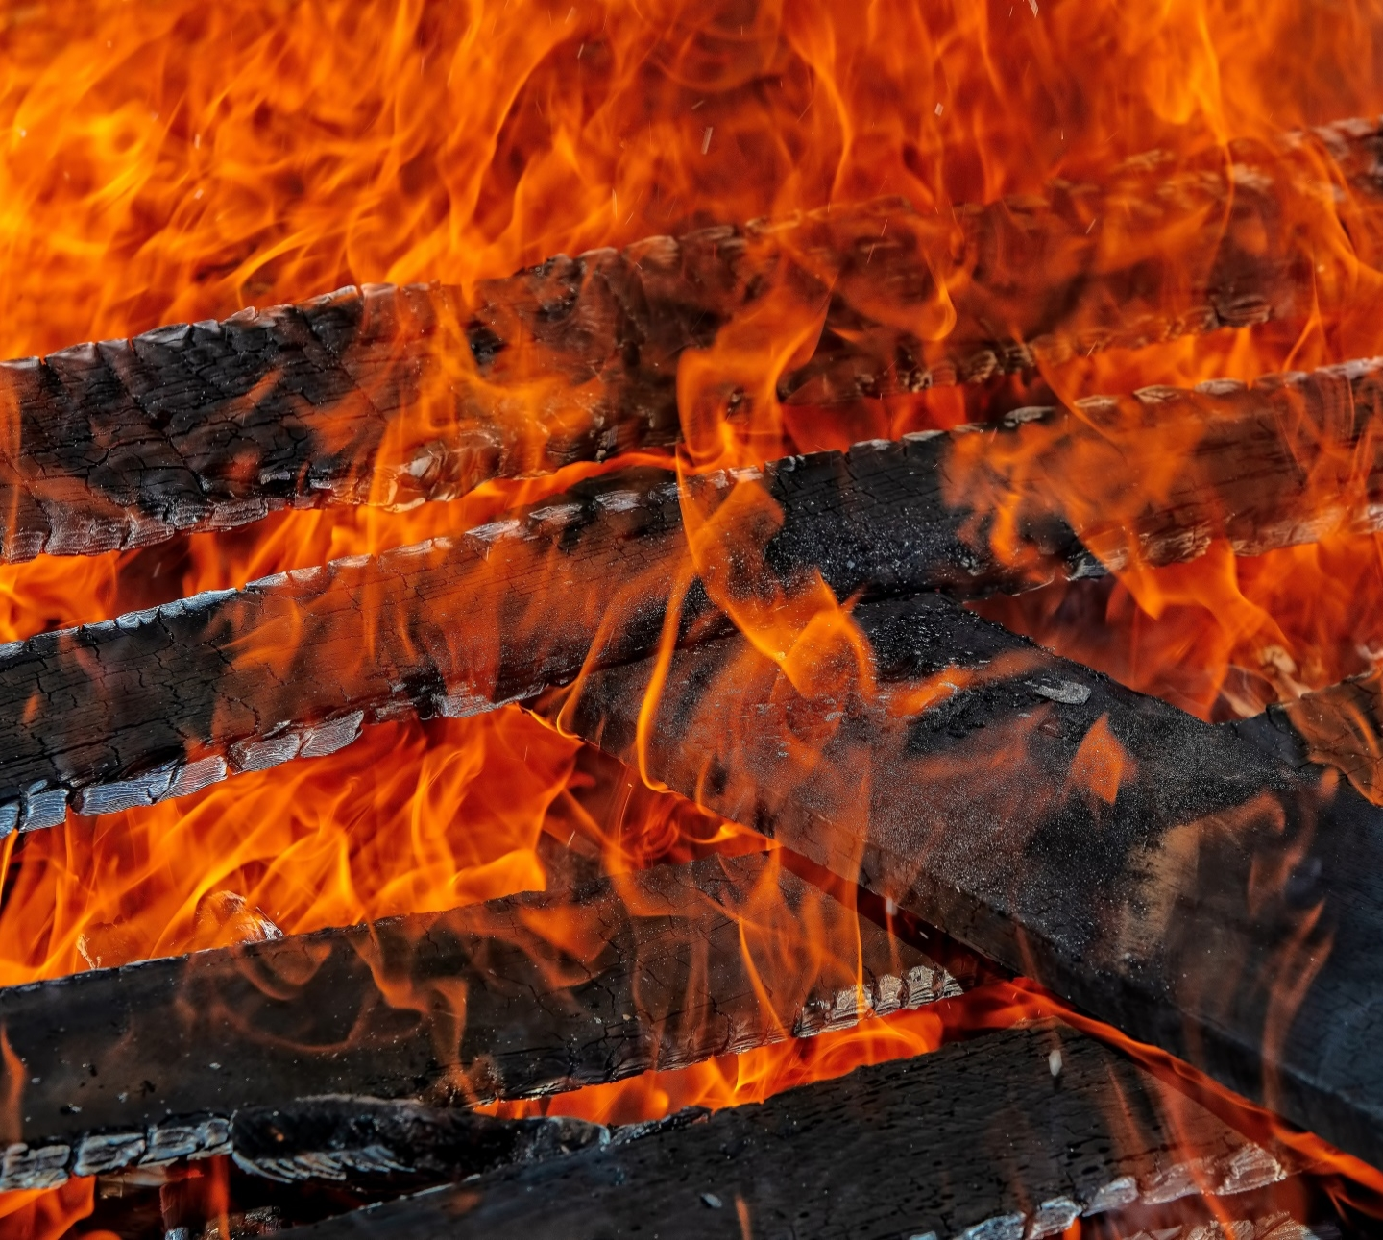

PowerShell Schedule Jobs and Toast Notifications
Josh King

Slide 6
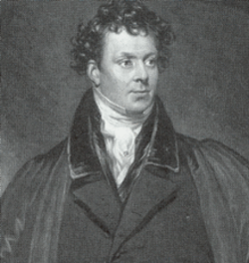
Who Am I?
Josh King
@WindosNZ

https://king.geek.nz
✶

Slide 7
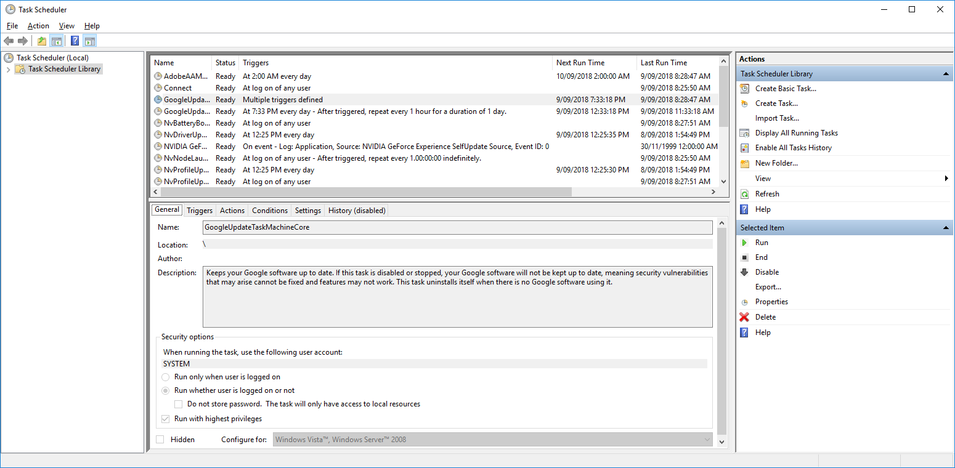
Did You Say Scheduled Tasks?

Slide 8
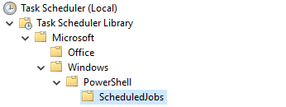
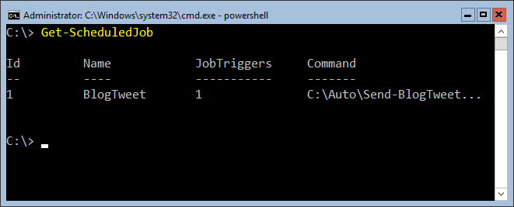
A Creepy Love Child

Slide 9
CODE TIME!

Slide 10
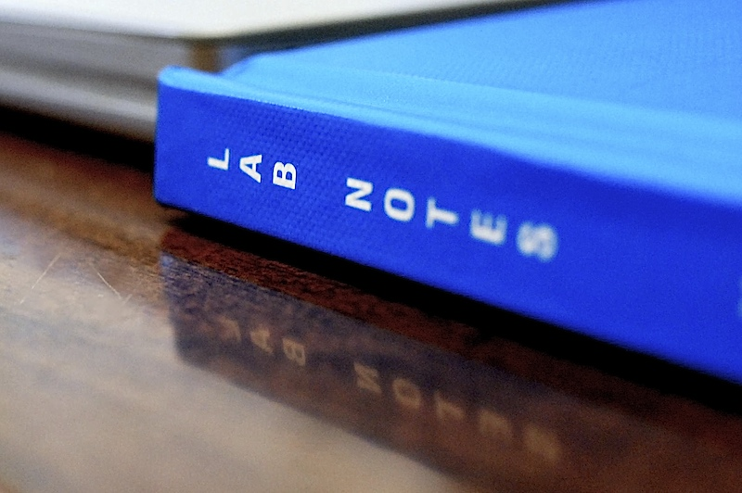
Takeaways
Marriage of Scheduled Tasks and Background Jobs
Can do anything you can do in normal PowerShell
Try not to spread them around the network

Slide 11
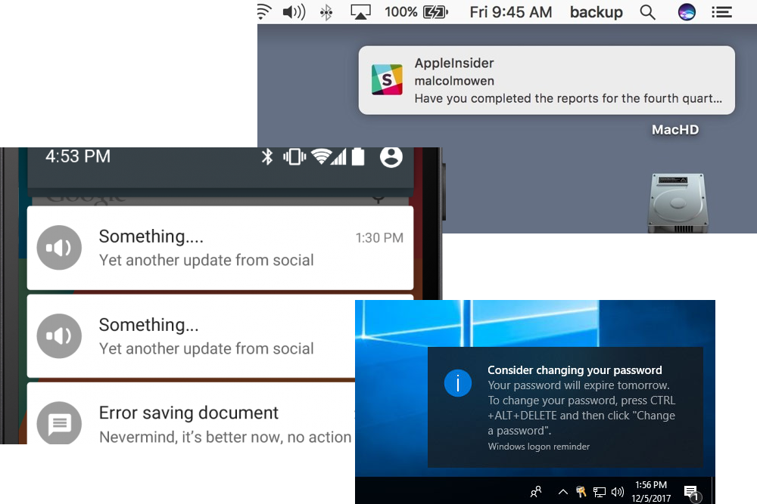
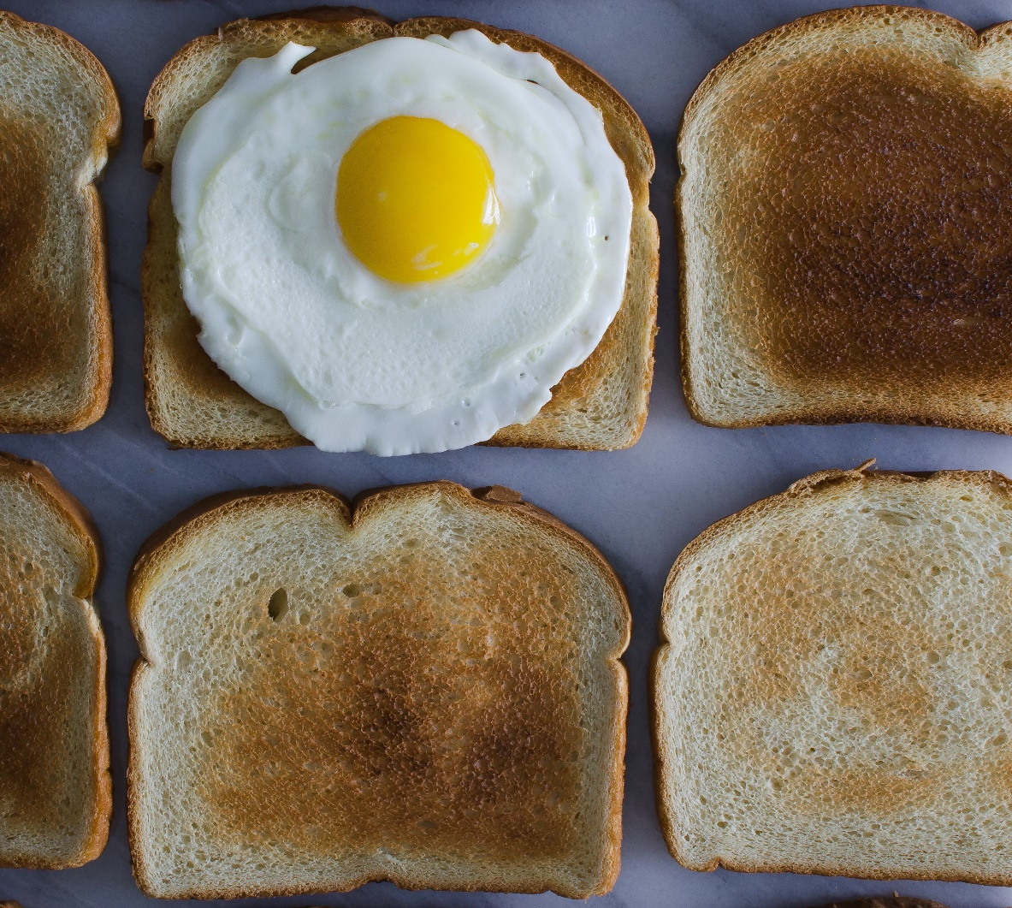
What Is Toast?

Slide 12

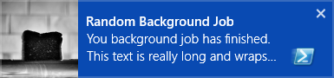

Slide 13
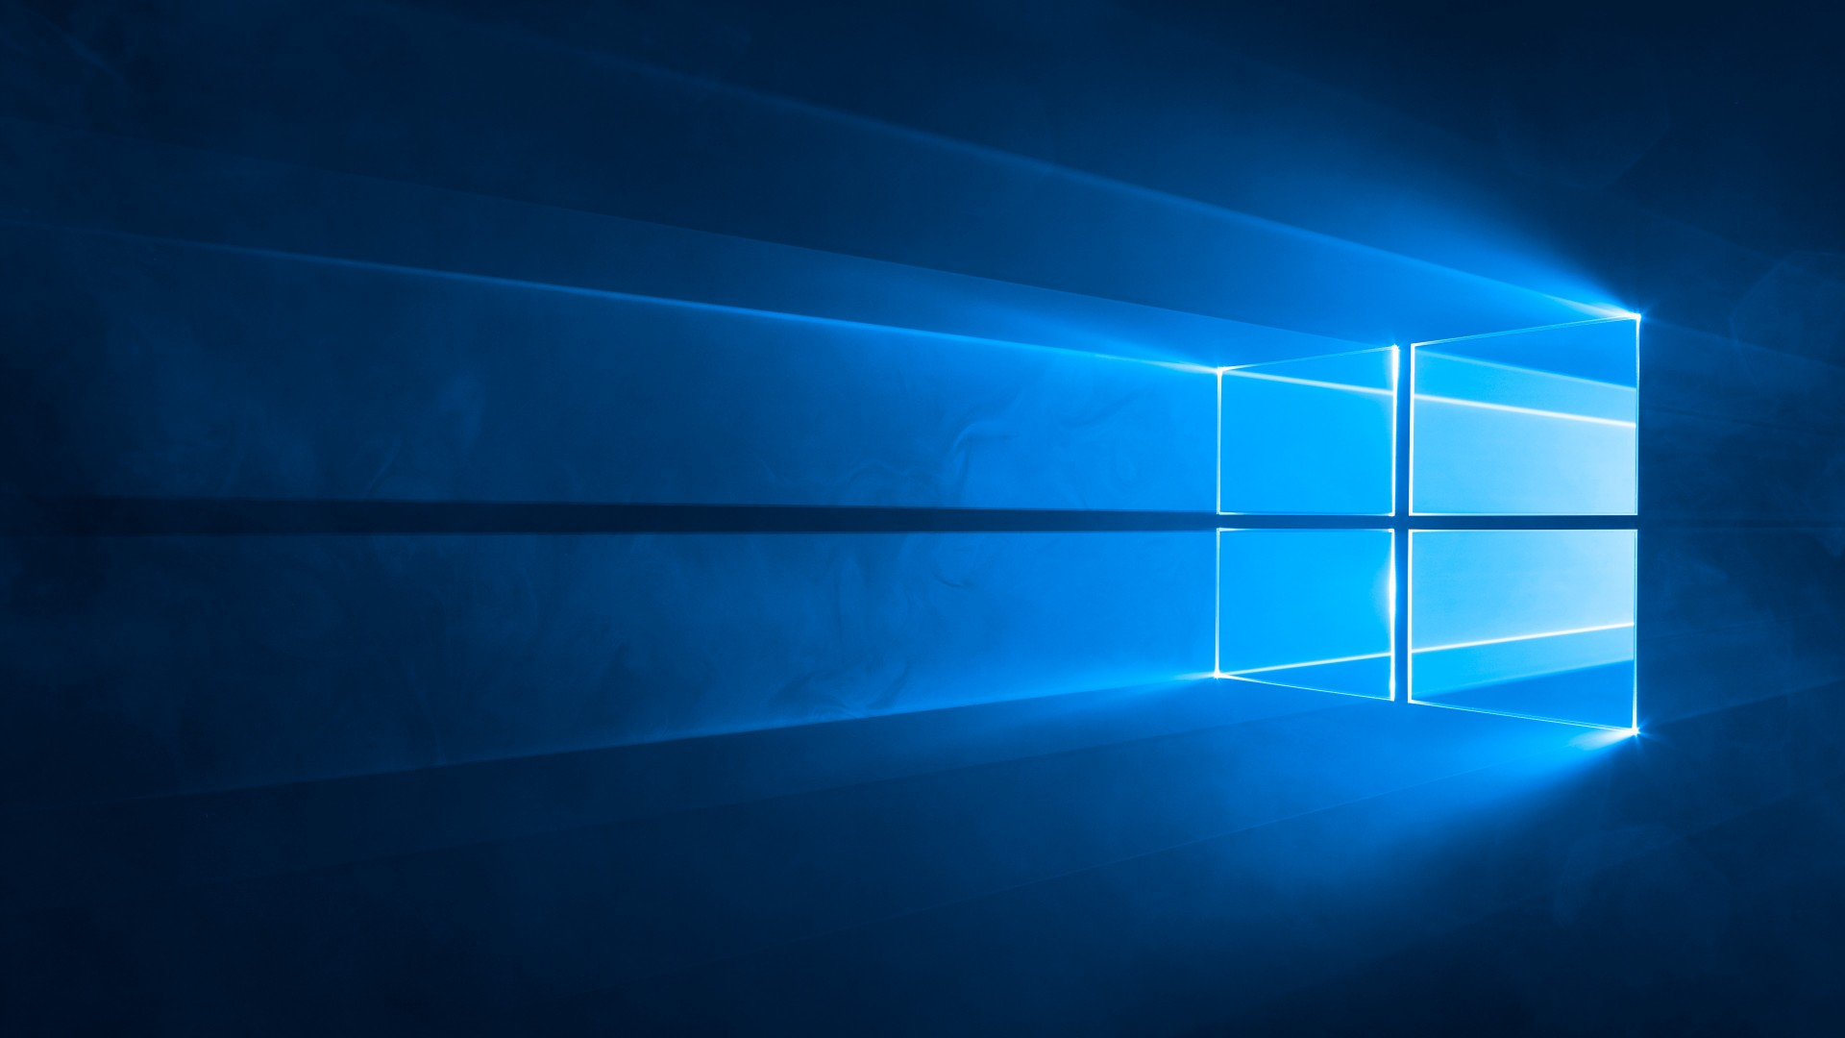
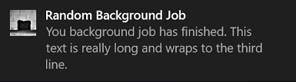

Slide 14

Anatomy of a Toast
It’s all XML:
<toast> <visual> <binding template="ToastGeneric"> <text>Default Notification</text> <image src="C:\Images\BurntToast.png" placement="appLogoOverride" hint-crop="circle" /> </binding> </visual> <audio src="ms-winsoundevent:Notification.Default" /> </toast>

Slide 15
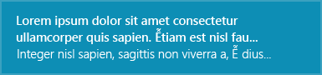
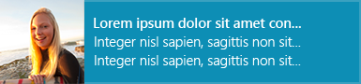
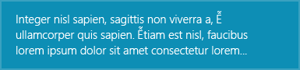
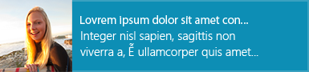
In the Beginning There Were Templates
The Docs
ToastText01 A single string wrapped across three lines of text.
ToastText03 One string of bold text wrapped across the first and second lines, one string of regular text on the third line.
ToastImageAndText02 A large image, one string of bold text on the first line, one string of regular text wrapped across the second and third lines.
ToastImageAndText04 A large image, one string of bold text on the first line, one string of regular text on the second line, one string of regular text on the third line.

Slide 16
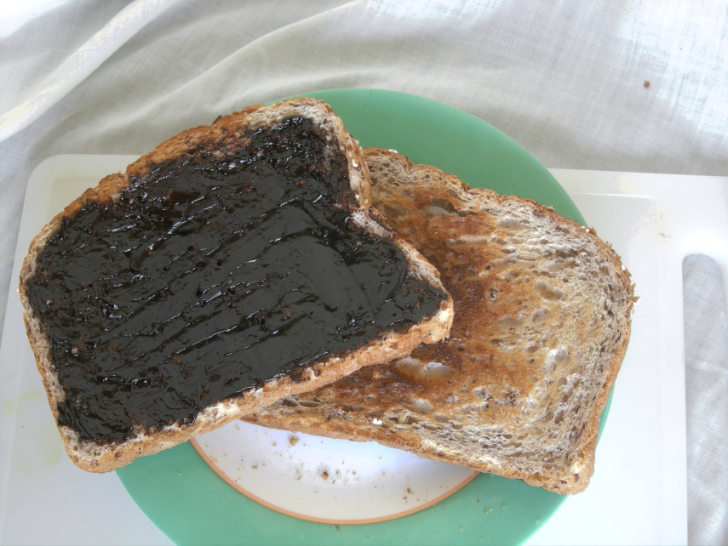
Now You Have to Be “Adaptive”…
One template to rule them all: ToastGeneric
Freedom to have your toast, your way

Slide 17
CODE TIME!

Slide 18

What’s Not Working
What’s Not Working Still Being Implemented
Events – Perform an action in code on click
Updatable toasts
Windows 10 Home Edition (Maybe?)
Updateable help

Slide 19
Takeaways
It’s all XML
You don’t need to touch XML
Leverage the UWP Windows Community Toolkit to roll your own
Use BurntToast
Let me know your use cases!

Slide 20
THANK YOU!
Get this slide deck from:
http://bit.ly/ANZPSUG-Sep18
Get in touch:
@WindosNZ

Slide 21
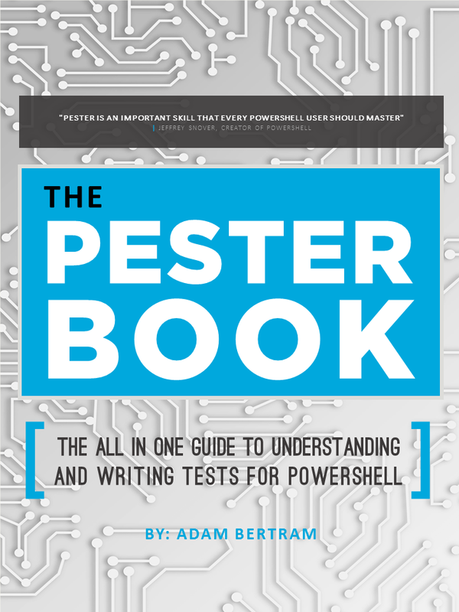
Finally: Book Giveaway
The Pester Book, by Adam Bertram
Provided by TechSnips

